Slide 1

Setting Up Your
Development Environment
www.profburnett.com
Master a Skill / Learn for Life

Slide 2

Development Environment
Web Hosting Company
Remote
Storage
Development Site
testing.itiwebcert.com
(Testing Server)
MC Online Storage
(UserID File Folder)
Client Computer
Local Storage
Hard Drive in Computer
or
USB Memory Stick
Live Web Site
remote.itiwebcert.com
(Remote Server)

Slide 3
Dreamweaver Development Environment
Dreamweaver Local Development Environment Folder:
Site Name: Create a site name.
Local Folder: pdrive\public\HTML5\{Your USERID}
Dreamweaver Remote Servers Setup Information
Developmental Site (Testing Server)
Server Name: {You name your development site)
FTP Address: develop.itiwebcert.com
Username: iti38934889D01
Password: *n-djMeg
Web URL: http:// develop.itiwebcert.com
This should be selected as your testing server.
Live Site (Remote Server)
Server Name: {You name your Live site)
FTP Address: remote.itiwebcert.com
Username: iti38934889L01
Password: ^nsDr^77
Web URL: http://remote.itiwebcert.com
This should be selected as your remote server.
Remote
Storage
Development Site
develop.itiwebcert.com
(Testing Server)
Live Web Site
remote.itiwebcert.com
(Remote Server)

Slide 4
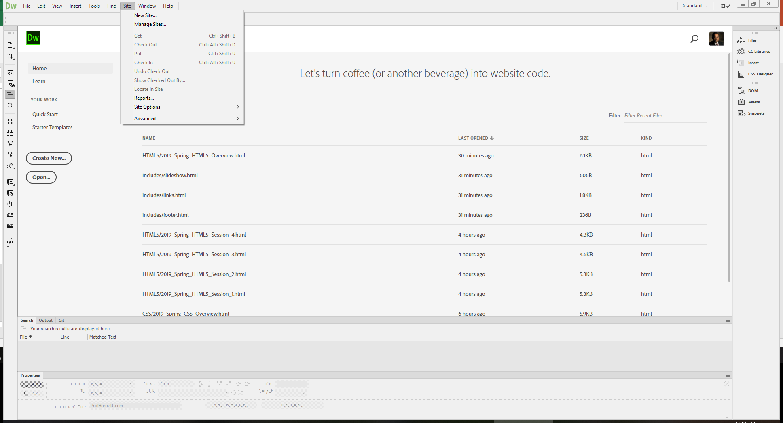

Slide 5
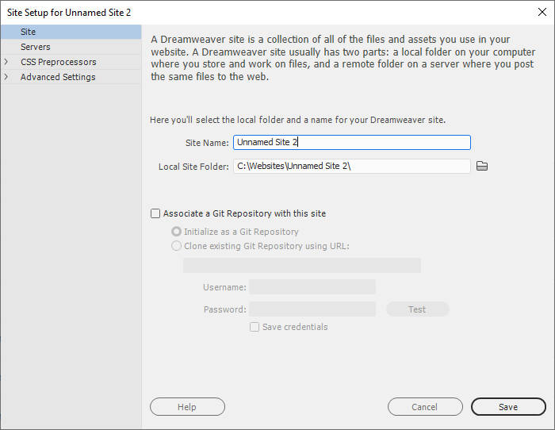
This is the name you give your site.
This is the MC Public shared drive folder with your userid.

Slide 6
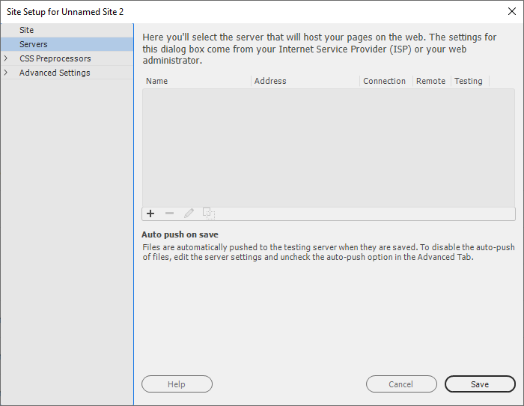
Push the “+” to add a server to the development environment.

Slide 7
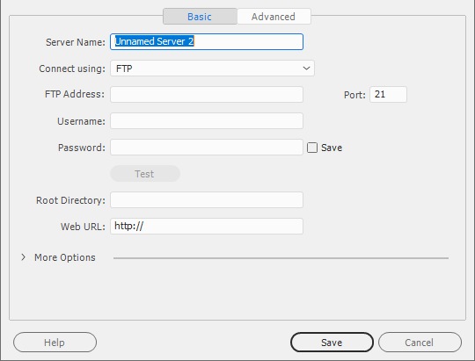
Development Server Setup
Server Name:
FTP Address:
Username:
Password:
After you complete this screen test your connection to the server. If you get an error check your FTP Address, Username, and Password and try again until it connects.
This should auto populate when the FTP address is added above. If not add -
http://testing.itiwebcert.com

Slide 8
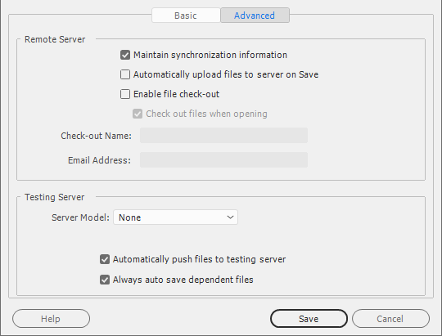
Development Server Setup
Activate the advanced tab
Select none for the testing server model.
Select auto Save option.

Slide 9
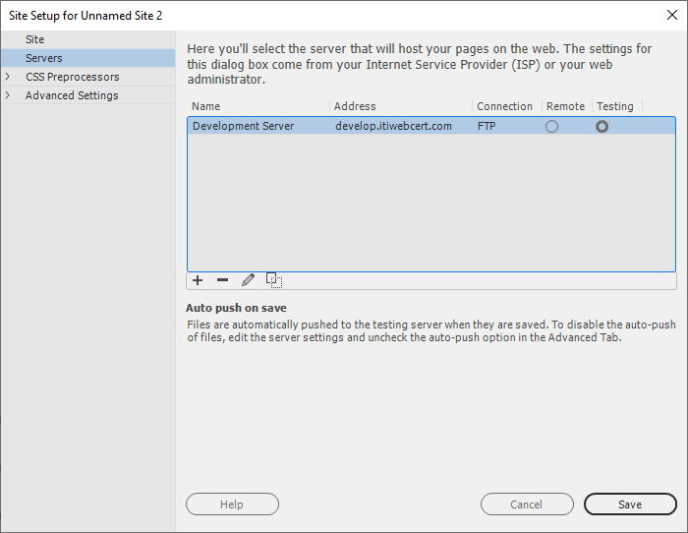
Select as the testing server
Push the “+” to add another server to the development environment.

Slide 10
Live Server Setup
Server Name:
FTP Address:
Username:
Password:
After you complete this screen test your connection to the server. If you get an error check your FTP Address, Username, and Password and try again until it connects.
This should auto populate when the FTP address is added above. If not add - http://remote.itiwebcert.com

Slide 11
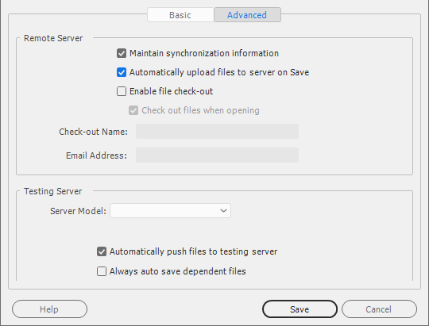
Live Server Setup
Activate the advanced tab
Select automatic upload on Save.

Slide 12
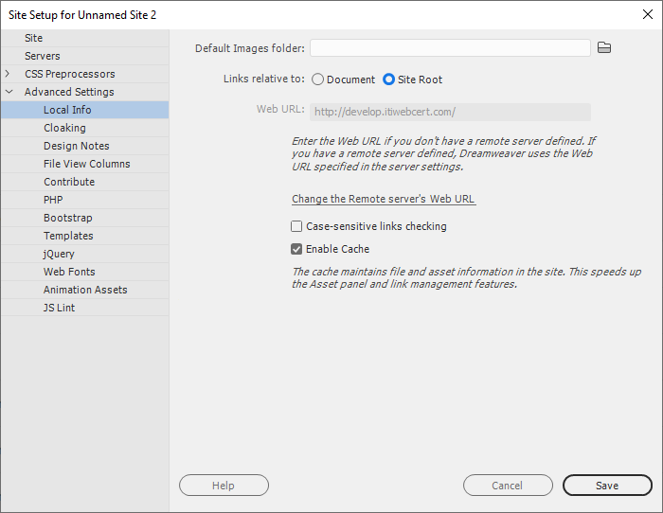
Live Server Setup
Activate the Advanced Settings – Local Info Tab
Activate the Links relative to site: Site Root option.

Slide 13
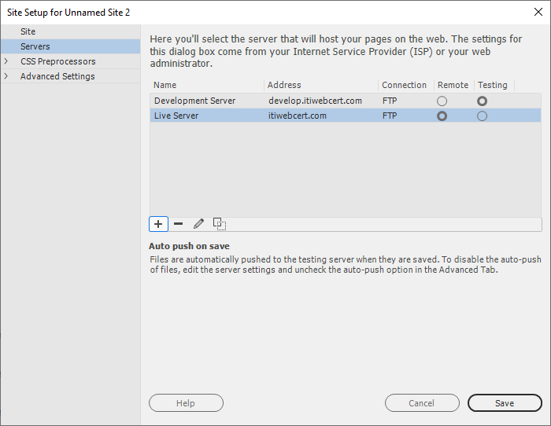
After all the selections are saved your site setup will look like this.
This will need to be done each class.

