Slide 1
HTML5-CSS3
Session X
Part 13 - How to Use CSS3 Transitions and Animation
www.profburnett.com
Master a Skill / Learn for Life

Slide 2
Properties for working with transitions
transition
transition-property
transition-duration
transition-timing-function
transition-delay
The syntax for the shorthand transition property
transition: [property] [duration] [timing-function]
[delay];

Slide 3
Transition - mouse hovers over a heading
Before the transition
During the transition

Slide 4
HTML Element Transitioned
<h1>Hover over this heading to see its transition</h1>
CSS for Two Property Transition
h1 { font-size: 120%;
color: blue;
transition: font-size 2s ease-out 1s,
color 2s ease-in 1s; }
h1:hover {
cursor: pointer;
font-size: 180%;
color: red; }

Slide 5
Transition for One Property
h1 { font-size: 120%;
transition: font-size 2s ease-out;
-webkit-transition: font-size 2s ease-out; }
h1:hover { font-size: 180%; }
Transition for All properties
transition: all 2s ease-out 1s

Slide 6
Accordion Created with CSS3 Transitions

Slide 7
HTML for Accordion
<h1>jQuery FAQs</h1>
<div id="accordion">
<h3><a href="#Q1">What is jQuery?</a></h3>
<div id="Q1">Contents for first panel</div>
<h3><a href="#Q2">Why is jQuery becoming so
popular?</a></h3>
<div id="Q2">Contents for second panel</div>
<h3><a href="#Q3">Which is harder to learn:
...?</a></h3>
<div id="Q3">Contents for third panel</div>
</div>

Slide 8
CSS for the Transitions
#accordion div {
overflow: hidden;
height: 0;
transition: height 2s ease-in-out;
-webkit-transition: height 2s ease-in-out;
}
#accordion div:target { height: 120px; }

Slide 9
Properties for 2D Transforms
transform, transform-origin
Methods for 2D transforms
rotate(angle)
rotateX(angle)
rotateY(angle)
scaleX(value)
scaleY(value)
scale(x-value,y-value)
skewX(angle)
skewY(angle)
skew(x-angle,y-angle)
translateX(value)
translateY(value)
translate(x-value,y-value)
matrix(a,b,c,d,e,f)

Slide 10
Image - Right Origin Rotated Right
The CSS for the transform
The HTML for the original and rotated images
<p><img src="images/01.jpg" >
<img src="images/01.jpg" class="image1">
</p>
.image1 {
transition: 2s; }
.image1:hover {
transform: rotateY(180deg);
transform-origin: right; }

Slide 11
Images with 8 different transforms applied

Slide 12
HTML for the Images with Transforms
<ul>
<li><p>Matrix</p><img src="images/01.jpg" class="image1"></li>
<li><p>Rotate</p><img src="images/02.jpg" class="image2"></li>
<li><p>ScaleX</p><img src="images/03.jpg" class="image3"></li>
<li><p>ScaleY</p><img src="images/04.jpg" class="image4"></li>
<li><p>SkewX</p><img src="images/05.jpg" class="image5"></li>
<li><p>SkewY</p><img src="images/06.jpg" class="image6"></li>
<li><p>TranslateX</p><img src="images/07.jpg" class="image7"></li>
<li><p>TranslateY</p><img src="images/08.jpg" class="image8"></li>
</ul>

Slide 13
The CSS for the 2D Transforms
.image1 {transform: matrix(0.5,0.5,-0.5,1,0,0);}
.image2 {transform: rotate(20deg);}
.image3 {transform: scaleX(1.4);}
.image4 {transform: scaleY(1.4);}
.image5 {transform: skewX(-20deg);}
.image6 {transform: skewY(-30deg);}
.image7 {transform: translateX(30px);}
.image8 {transform: translateY(20px);}

Slide 14
Properties for Animations
animation
animation-name
animation-duration
animation-delay
animation-iteration-count
animation-timing-function
animation-direction
Syntax for Shorthand Animation Property
animation: [name] [duration] [timing-function] [delay]
[iteration-count] [direction];

Slide 15
A simple animation that moves a heading and changes its color Starting in blue with a left margin of 20%
Ending in red with a left margin of 60%

Slide 16
HTML for the Heading
<h1>This text will animate.</h1>
The CSS for the animation
h1 {animation: moveright 3s 2s infinite ease-in-out
alternate; }
@keyframes moveright {
from { margin-left: 20%;
color: blue; }
to { margin-left: 60%;
color: red; }
}

Slide 17
Slide Show Animation with Captions
The HTML for an unordered list that contains the images and captions
The CSS for the animation
<ul>
<li>
<h2>Front of Building</h2>
<img src="images/01.jpg" alt="">
</li>
...
</ul>
ul { animation: slideshow 15s infinite alternate; }
@keyframes slideshow {
0% {left: 0%;}
10% {left: 0%;}
20% {left: -100%;}
30% {left: -100%;}
40% {left: -200%;}
50% {left: -200%;}
60% {left: -300%;}
70% {left: -300%;}
80% {left: -400%;}
90% {left: -400%;}
100% {left: -400%;}
}
The CSS for the ul and li elements
ul { list-style: none;
width: 500%;
position: relative; }
ul li { width: 20%;
float: left; }

Slide 18
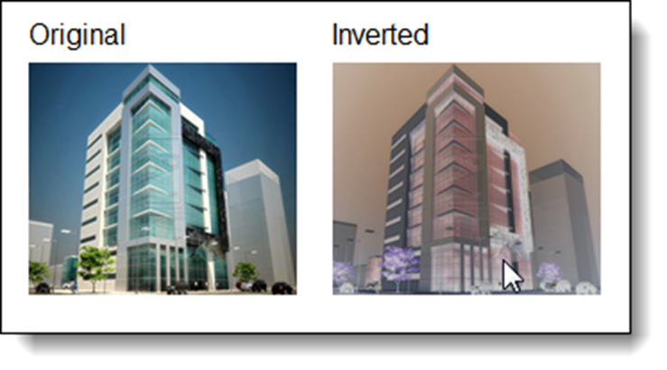
The syntax for adding a filter to an element
filter: filtermethod(value);
An image before and after its colors are inverted
The filter methods
blur(value)
brightness(value)
contrast(value)
drop-shadow(values)
grayscale(value)
hue-rotate(angle)
invert(value)
opacity(value)
saturate(value)
sepia(value)
The HTML for the images
<li>Original<br><img src="images/01.jpg" alt=""></li>
<li>Inverted<br><img src="images/01.jpg" class="image1” alt=""></li>
The CSS for the filter
.image1:hover { filter: invert(.80); )

Slide 19
Different filters applied to an image in Chrome

Slide 20
HTML for the Images
CSS for the Filters
<ul>
<li>Blur<br> <img src="images/01.jpg" class="image1“ alt=""></li>
<li>Brightness<br> <img src="images/01.jpg" class="image2“ alt=""></li>
<li>Contrast<br> <img src="images/01.jpg" class="image3“ alt=""></li>
<li>Drop Shadow<br> <img src="images/01.jpg" class="image4“ alt=""></li>
<li>Grayscale<br> <img src="images/01.jpg" class="image5“ alt=""></li>
<li>Hue Rotate<br> <img src="images/01.jpg" class="image6“ alt=""></li>
<li>Invert<br> <img src="images/01.jpg" class="image7“ alt=""></li>
<li>Opacity<br> <img src="images/01.jpg" class="image8“ alt=""></li>
<li>Saturate<br> <img src="images/01.jpg" class="image9“ alt=""></li>
<li>Sepia/blur<br> <img src="images/01.jpg" class="image10“ alt=""></li>
</ul>
.image1 { filter: blur(2px); }
.image2 { filter: brightness(50%); }
.image3 { filter: contrast(50%);}
.image4 { filter: drop-shadow(2px 2px 5px #333); }
.image5 { filter: grayscale(50%); }
.image6 { filter: hue-rotate(90deg); }
.image7 { filter: invert(.8); }
.image8 { filter: opacity(.50); }
.image9 { filter: saturate(30%); }
.image10{ filter: sepia(100%) blur(1px); }

Slide 21
Part 13 Exercise
Students will complete Part 13 exercise in developmental PDF.
Students will upload files to testing site.
Students will preview in browser testing site files.
Students will upload files to live site.
Students will preview in browser live files.

